Slide 1



Data Science Methods for Clean Energy Research (DSMCER) & Software Engineering for (SEMDS) Molecular Data Scientists
Knowledge and solutions for a changing world
Advancing data-intensive discovery in all fields
Be boundless
UW DIRECT
(Data Intensive Research Enabling Cutting-edge Tech)
https://uwdirect.github.io
Stéphanie Valleau
Chemical Engineering
Dave Beck (dacb)
eScience/Chemical Engineering
Notes:
In the SEDS portion of the class, we mostly focus on structure rather than content: knowing how to interact with the Shell, getting familiar with Github tools, etc. But in the DSMCER lectures, we’re going to focus more on content: on solving particular problems with the tools we learn about in SEDS. Know, the DSMCER material is also a set of tools that can be applied to a wide set of problems: and we aren’t going to get too mired down in any one domain science. But there is a difference.
Let me tell you about my experience with data science. I came to the University of Washington with absolutely no idea what “data science” meant. I had a little MatLab coding experience, but I found any type of computational work outright intimidating. So maybe a lot like you. And when I got started with programming, I was a little impatient with all this SEDS stuff. All this git add, git commit, git pull– it added nothing of value to my immediate problem! It didn’t help me analyze my data, etc. It only came over time working in the eScience Institute with data scientists that I began to see its value. So don’t give up yet.
Today, we’re going to focus on a subset of problems within data science, what we’re referring to as data visualization. So making pretty graphs. Kind of a fun one right?
By the end of today, I want you to feel comfortable using a few basic tools within three Python packages (Pandas, Matplotlib, and Seaborn) that can help you make some simple graphs.
I was you to feel comfortable accessing reference materials online to do more complex operations to make your graphs even prettier.
And I want to give you a few guiding principles when designing figures, plots, and graphs.
And ultimately, I want to convince you that you can and should try making your plots with Python instead of alternatives such as Excel or more sophisticated programs like GraphPad.

Slide 2
What is this class about?
Overview of Data Science methods
Basics of statistics
Tool selection
Best practices
Not about designing new algorithms
Group project using these methods
Provide you with computational tools and a computational mindset to tackle science problems

Slide 3
Course website & setup
Class website: https://uwdirect.github.io
Let’s go there now!
Equipment / work platforms
Laptops: use them ☺!
Slack: use it!
Software: install it!

Slide 4
Panopto recordings
We will record all lectures using Panopto – these will include the speaker’s screen and audio.
For virtual lectures (first week), your names / chats and videos are not recorded – even when your videos are turned on!

Slide 5
Code of Conduct
Please read and make sure to respect the code of conduct
https://uwdirect.github.io/code_of_conduct.html
If you find cases where the code of conduct is not being respected, let us know!
If you do not respect the code of conduct, we may refer to the university for action.

Slide 6
Two quarters of courses in one!
Two quarter courses make up training
CHEME 546: Software Engineering for Molecular Data Scientists (SEMDS)
One quarter (10 weeks)
CHEME 545: Data Science Methods for Chemical Engineering Research (DSMCER)
One quarter (10 weeks)
UW runs these concurrently
SEMDS
DSMCER
Week 1 |  | Week 2 |  | Week 3 |  | Week 4 |  | Week 5 |  | Week 6 |  | Week 7 |  | Week 8 |  | Week 9 |  | Week 10
AM
PM

Slide 7
Two quarters of courses in one!
Two quarter courses make up training
CHEME 546: Software Engineering for Molecular Data Scientists (SEMDS)
One quarter (10 weeks)
CHEME 545: Data Science Methods for Chemical Engineering Research (DSMCER)
One quarter (10 weeks)
We run these concurrently
SEMDS
DSMCER
Week 1 |  | Week 2 |  | Week 3 |  | Week 4 |  | Week 5 |  | Week 6 |  | Week 7 |  | Week 8 |  | Week 9 |  | Week 10
AM
PM

Slide 8
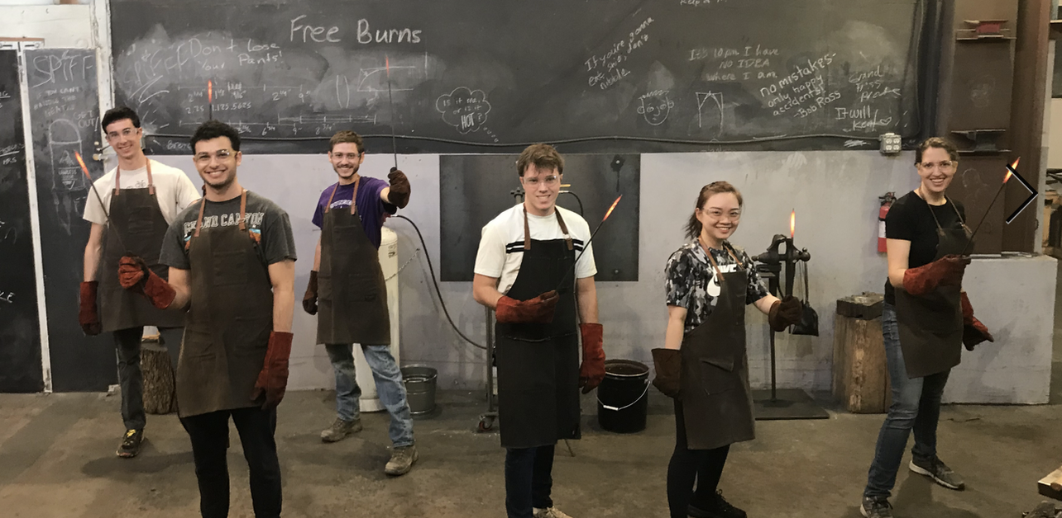
About Stéphanie Valleau
Background – Chemistry (BS), Chemical Physics (MS, PhD), Physics (AM), Computer science (Secondary field)
Research – Solve chemical problems using computers (no gloves ;) ) – kinetics / exciton transport – from ab initio to ML predictions
Office: Zoom and Slack
Email: valleau+dsms@uw.edu
Group webpage: valleau-lab.com

Slide 9
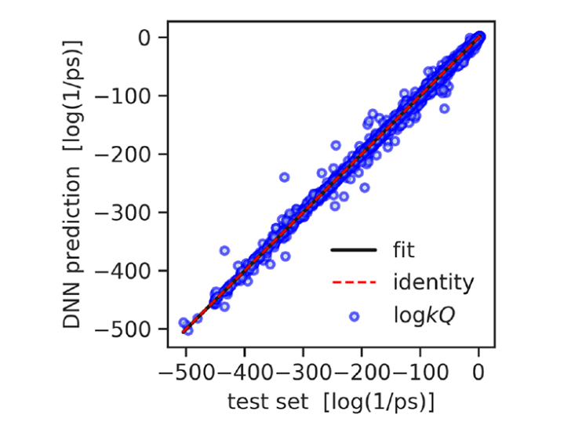
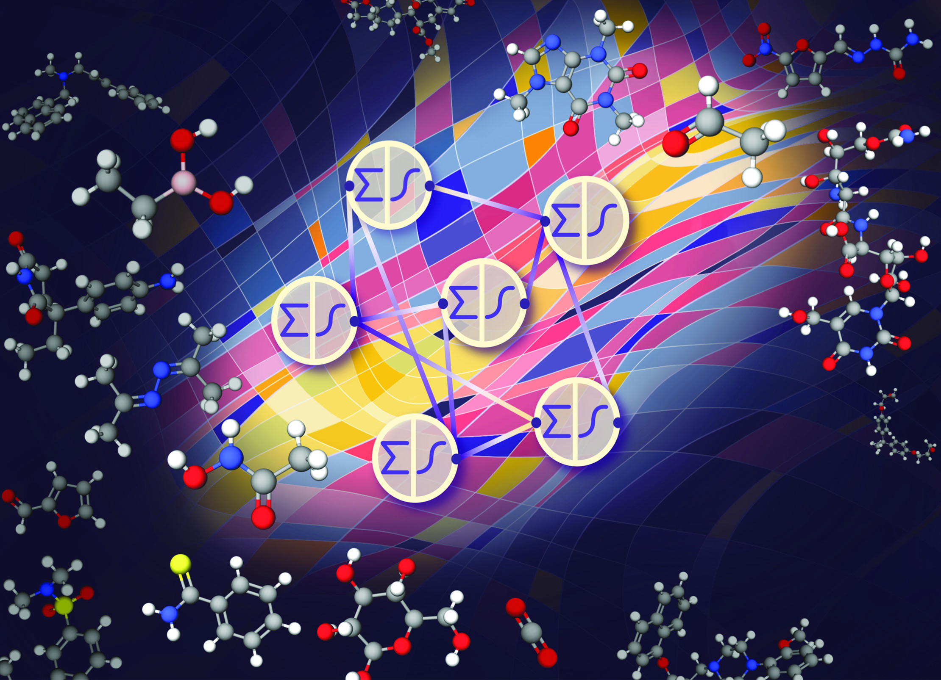
Data science + Kinetics
Predict reactivity using machine learning, ML, algorithms – e.g. neural networks (large speedup – months to minutes)
Quantum rate constants [1]
Kinetics [2]
[1] Komp, E.; Valleau, S. J. Phys. Chem. A., 124, 41, 8607–8613, 2020
[2] Komp. E; Janulaitis, N.; Valleau, S. PCCP, https://doi.org/10.1039/D1CP04422B, 2022

Slide 10
About Dave Beck
Background – Computer science, biology, chemistry (BS); Medicinal Chemistry (PhD); BioE (post-doc)
Research – Molecular data science with applications in energy, environment and health. Scientific software engineering for reproducibility.
Molecular mechanics
*omics
ML in molecular settings
Office: Zoom and Slack
Email: dacb@uw.edu

Slide 11
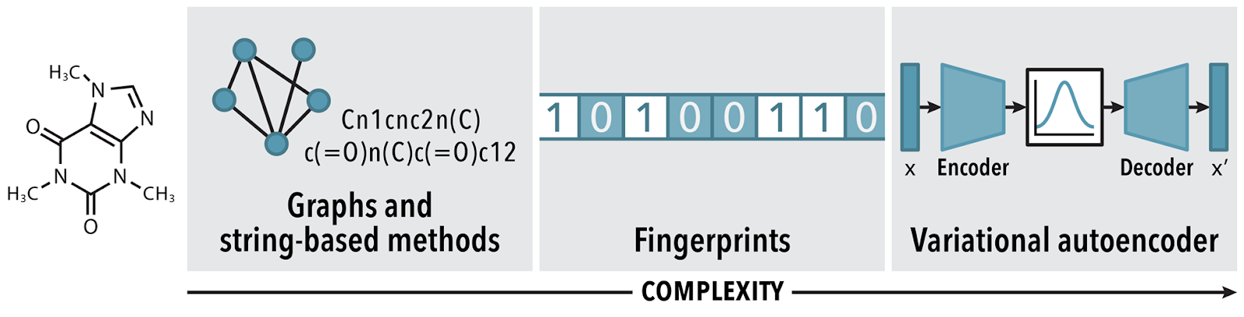
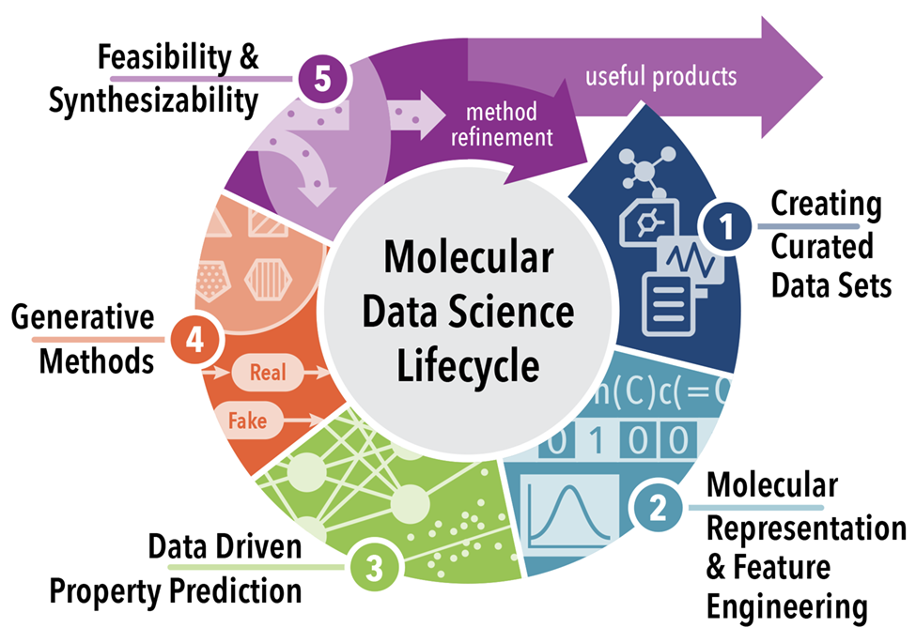
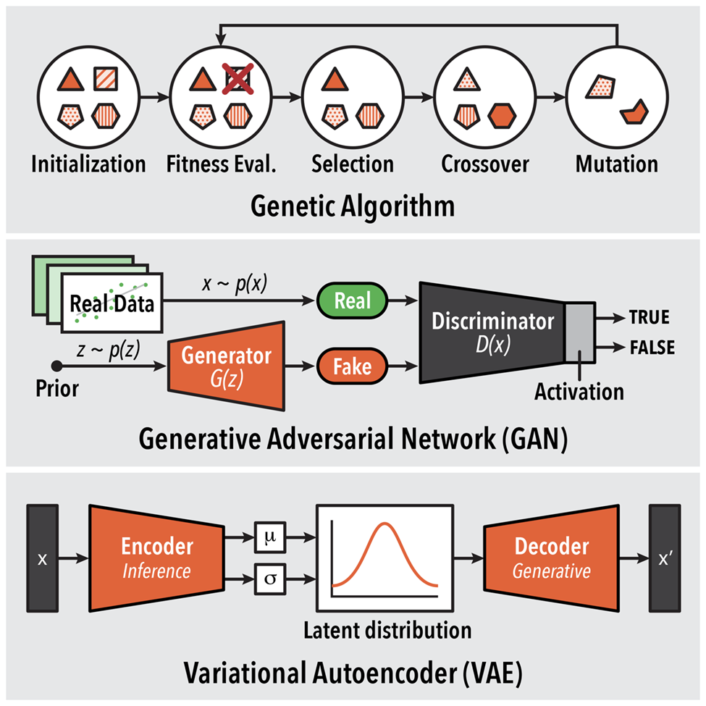
Molecular Data Science
Combining (a) diverse data sources and unique (b) molecular representations and (c) generative models to design new molecules.
(b)
(a)
(c)
[1] Ashraf, Joshi, Beck, Pfaendtner. Ann. Rev. Bio. Chem. Eng. https://doi.org/10.1146/annurev-chembioeng-101220-102232

Slide 12

About Evan Komp
I am concerned with leveraging machine learning to predict kinetic parameters allowing for speedy design of gas phase systems such as carbon capture in flue gas or precursor in chemical vapor manufacturing techniques. I am super excited to develop tools bringing the informatics of data science to kinetics design and to drive the community in terms of minimizing waste and energy use.
Office: Zoom and Slack
Email: evankomp@uw.edu

Slide 13
About Nisarg Joshi
I’m a third year PhD student in Pfaendtner Research Group. I use neural networks for my research to study simulations. Excited to be a part of DIRECT again! Data Science rocks!!
Office: Zoom and Slack
Email: nisargj@uw.edu

Slide 14

Data + science?
Science, Art & Engineering
Physical Sciences: Physics, Chemistry, Biology, Molecular science
Engineering: Environment, Materials, Civil, Electrical
Social Sciences: Psychology, Economics, Sociology, Public Policy

Slide 15
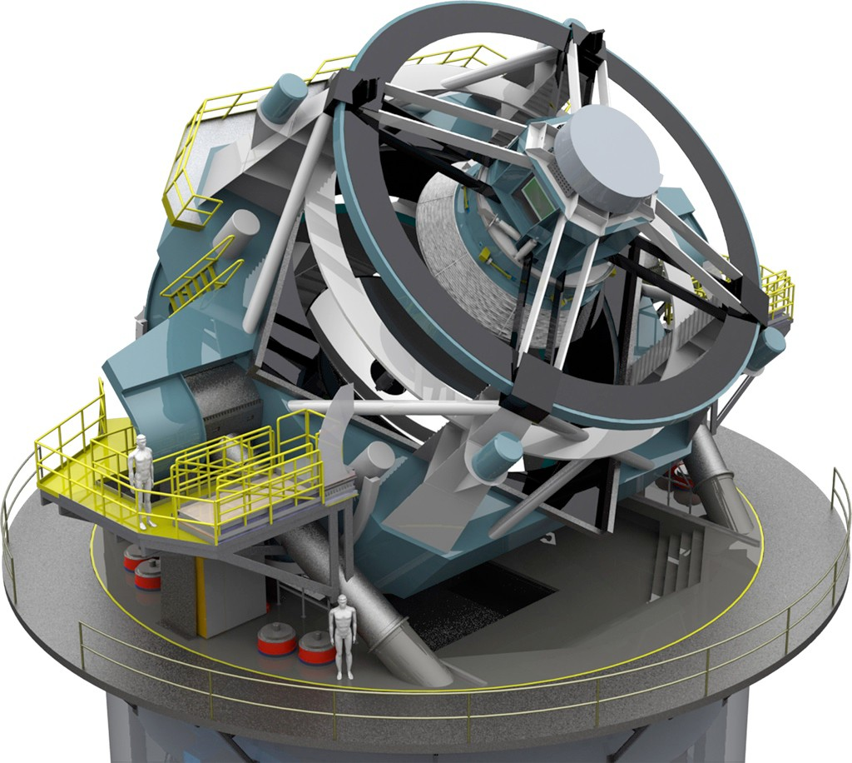

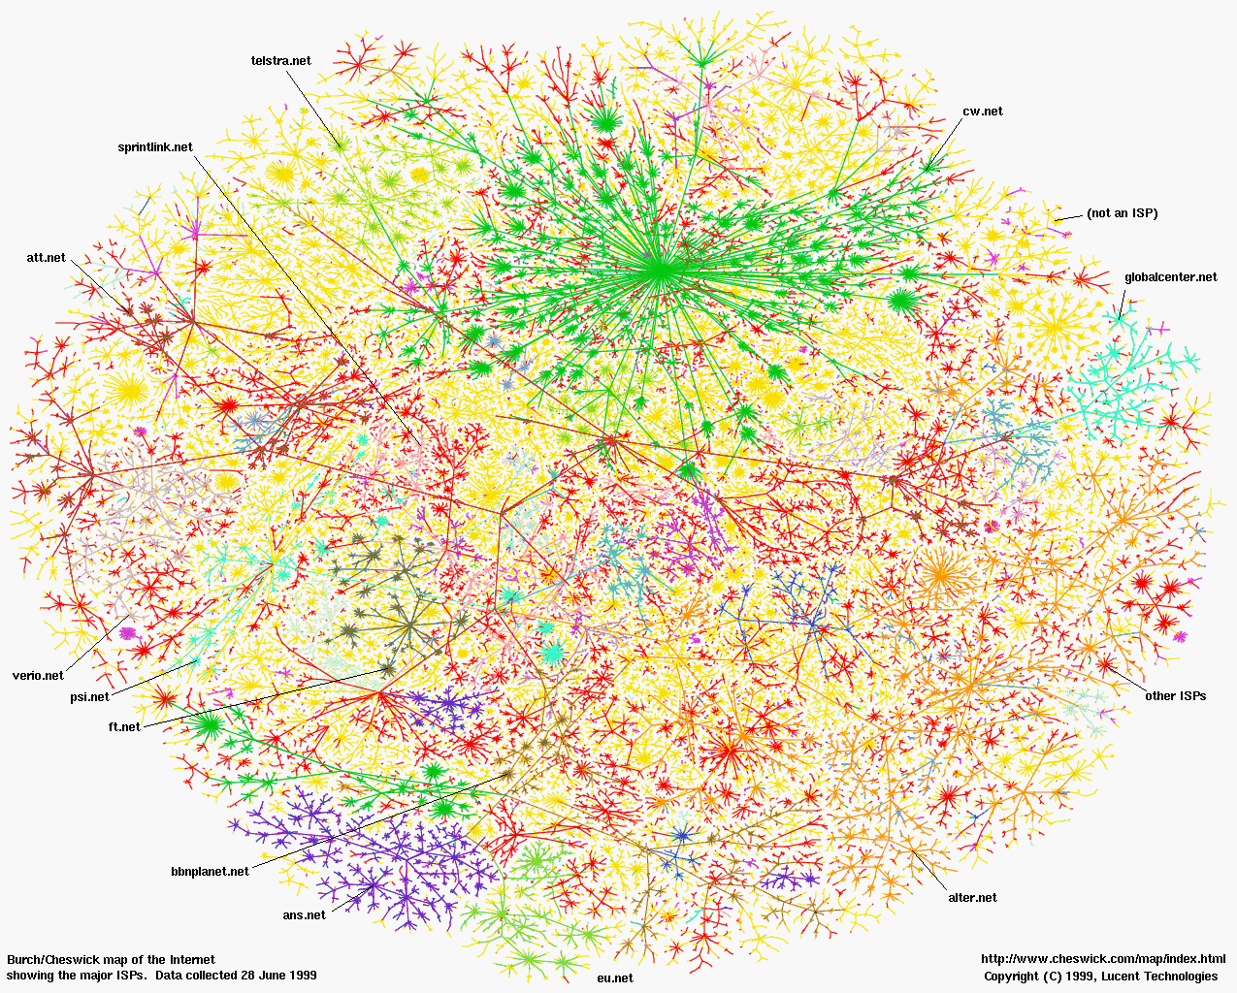
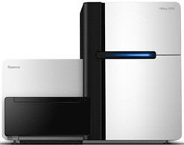
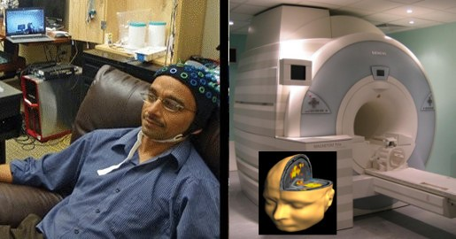
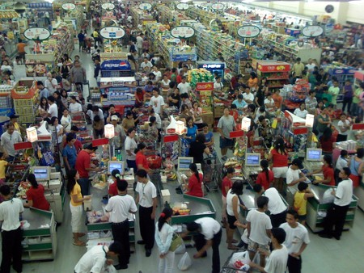
OMG, so much data!
All fields of science: “data poor” → “data rich”
Astronomy: LSST
Physics: LHC
Sociology: Social networks
Biology: Sequencing
Neuroscience: EEG, fMRI
Economics: POS terminals

Slide 16


Computers then and now
1943
2018
ENIAC - Electronic Numerical Integrator and Computer
High-speed memory - 20 words (equivalent to about 80 bytes)
simple calculations involving 20 numbers of ten decimal digits
add and subtract 5000 times per second
SUMMIT - 2nd fastest in the world
Non-volatile memory per node 1600 gigabytes GB
mathematical calculations at the rate of 200 quadrillion per second, or 200 petaflops
https://en.wikipedia.org/wiki/Computer#First_computing_device
https://www.olcf.ornl.gov/summit/
Notes:
RAM 1963
The basic machine cycle was 200 microseconds (20 cycles of the 100 kHz clock in the cycling unit), or 5,000 cycles per second for operations on the 10-digit numbers. In one of these cycles, ENIAC could write a number to a register, read a number from a register, or add/subtract two numbers.
The ENIAC^{[37]} (Electronic Numerical Integrator and Computer) was the first electronic programmable computer built in the U.S. Although the ENIAC was similar to the Colossus, it was much faster, more flexible, and it was Turing-complete. Like the Colossus, a "program" on the ENIAC was defined by the states of its patch cables and switches, a far cry from the stored program electronic machines that came later. Once a program was written, it had to be mechanically set into the machine with manual resetting of plugs and switches. The programmers of the ENIAC were six women, often known collectively as the "ENIAC girls".^{[38][39]}
It combined the high speed of electronics with the ability to be programmed for many complex problems. It could add or subtract 5000 times a second, a thousand times faster than any other machine. It also had modules to multiply, divide, and square root. High speed memory was limited to 20 words (about 80 bytes). Built under the direction of John Mauchly and J. Presper Eckert at the University of Pennsylvania, ENIAC's development and construction lasted from 1943 to full operation at the end of 1945. The machine was huge, weighing 30 tons, using 200 kilowatts of electric power and contained over 18,000 vacuum tubes, 1,500 relays, and hundreds of thousands of resistors, capacitors, and inductors.^{[40]}

Slide 17
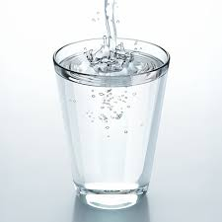
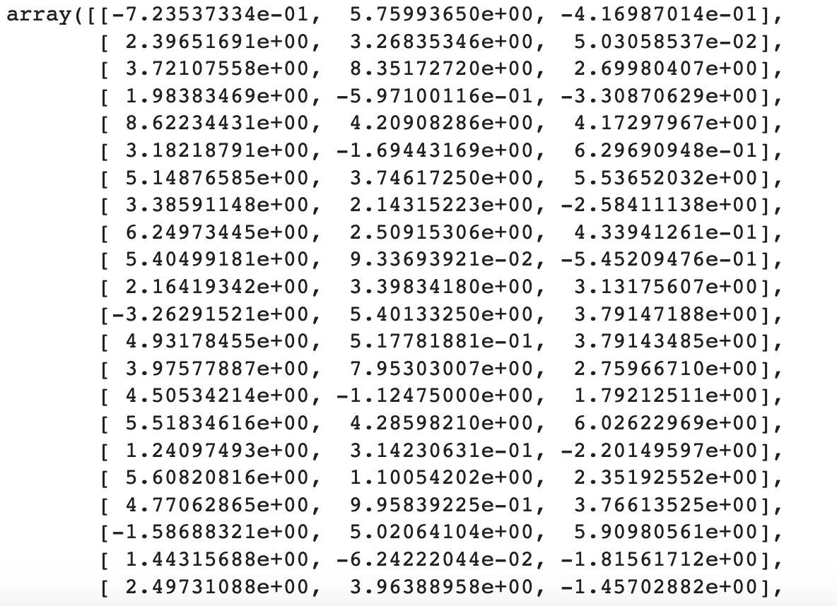
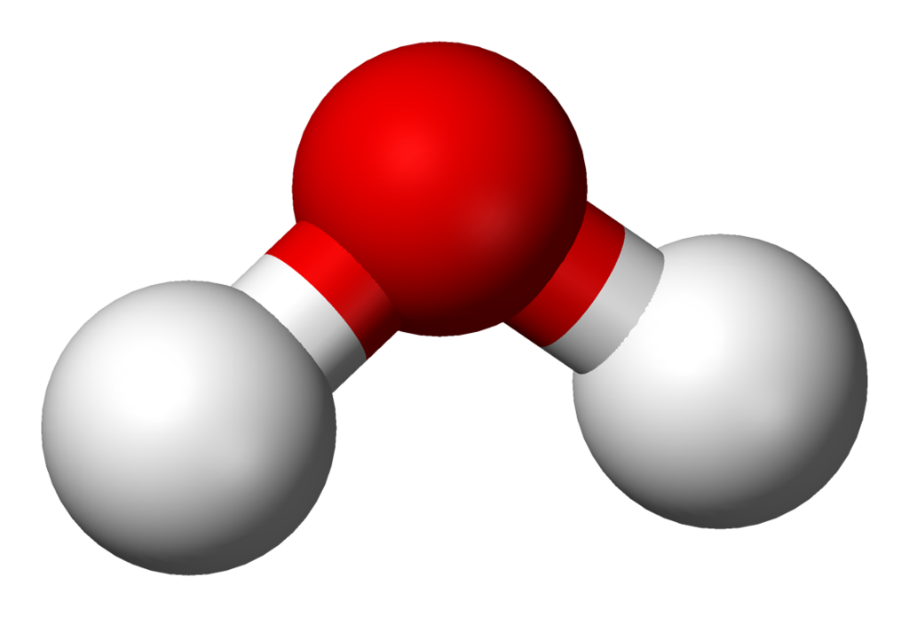
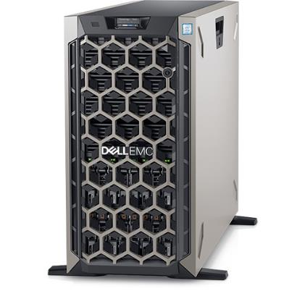
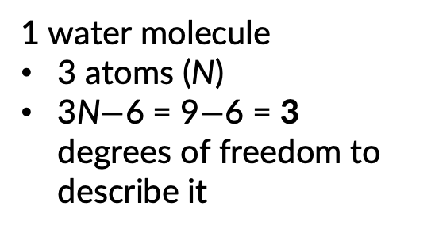
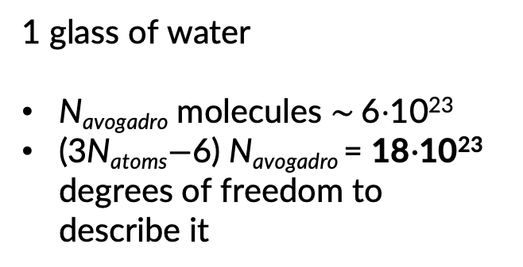
Where does all the data come from?
Tracking the motion of molecules (data points)
chemistry / chemical engineering / material science
Many positions!!! (data!)
X Y Z
1 water molecule
3 atoms (N)
3N$−$6 = 9$−$6 = 3 degrees of freedom to describe it
1 glass of water
N_{avogadro} molecules $\sim \text{6}\text{⋅}\text{10}\text{23}$
(3N_{atoms}$−$6) N_{avogadro} = 18$\text{⋅10}\text{23}$ degrees of freedom to describe it

Slide 18
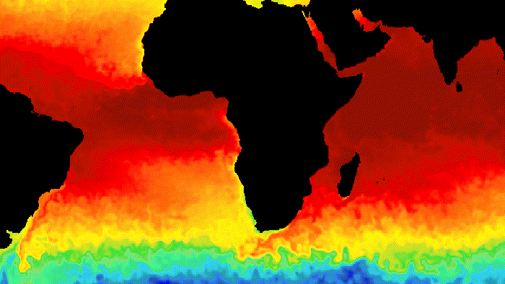
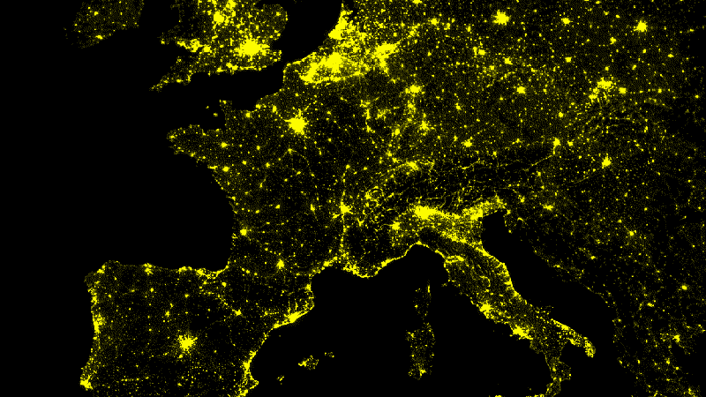
Where does all the data come from?
Satellite images / Measurements (images)
See e.g. 40 years of data made available here
https://developers.google.com/earth-engine/datasets
Earth temperature
Night time imagery
Each image and data point occupies space “bytes” in a computer’s memory!

Slide 19
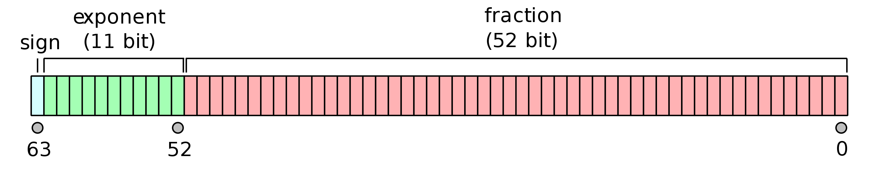


Need memory to store data
One double precision number (16 significant figures) needs 64 bits – 8 bytes
3.141592653589793115997963468544185161590576171875
$$π$$

Slide 20

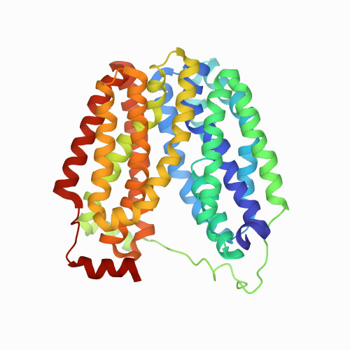
Ok so for N_{av} molecules????
We just need 18E+23 numbers to be stored so ….
14400000000000 Terabytes
Even for a single protein we need to
store a lot of data e.g. lactose permease
1PV6 – 6580 atoms – 138 kilobytes KB

Slide 21
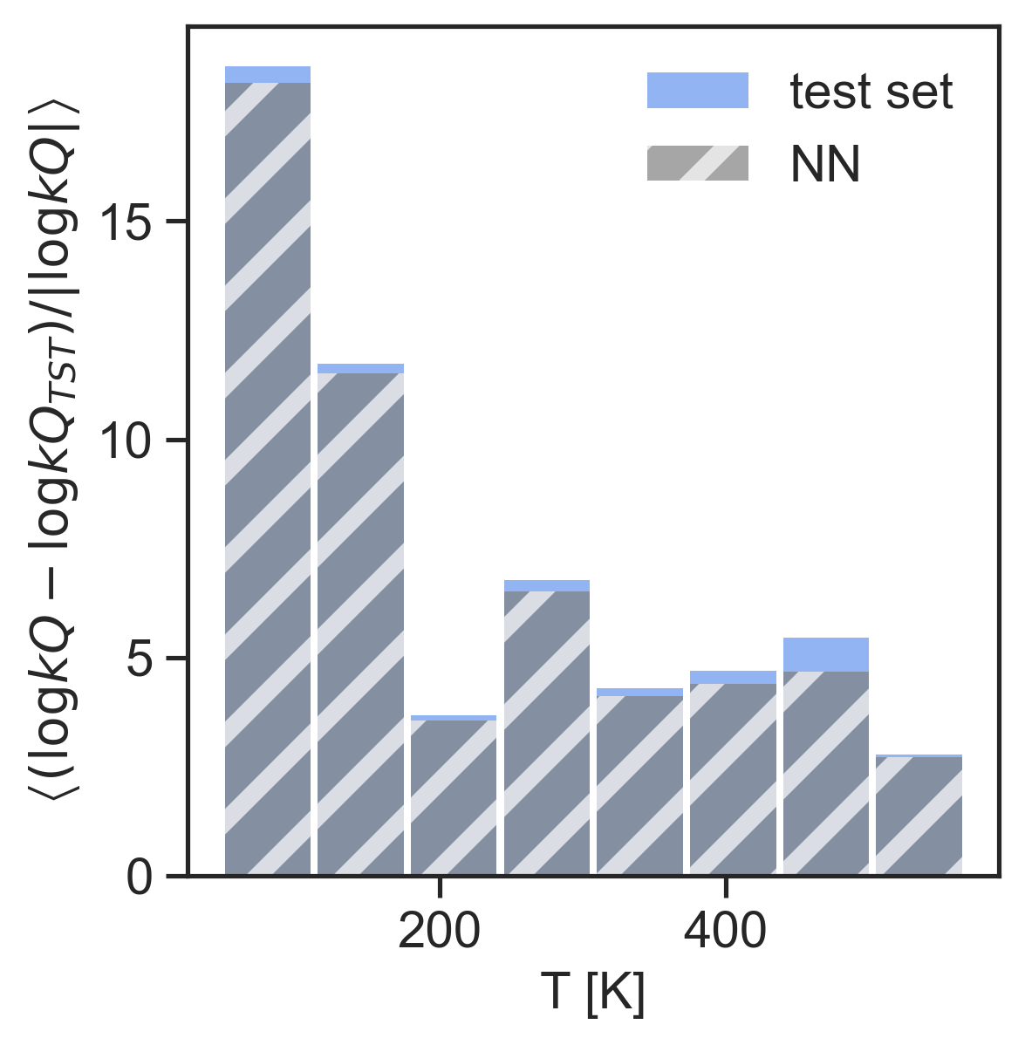

Memory & time to compute
Now we want to model or visualize our data
Modeling data – load data in e.g. lists, vectors, matrices and apply mathematical operations / functions on the data such as sums, products etc.
Visualizing data – load data in e.g. lists, vectors, matrices and convert it into a graphical representation
When we load data, it is stored in random access memory RAM – the larger the dataset the more memory we need.
COMPUTER + CODE

Slide 22
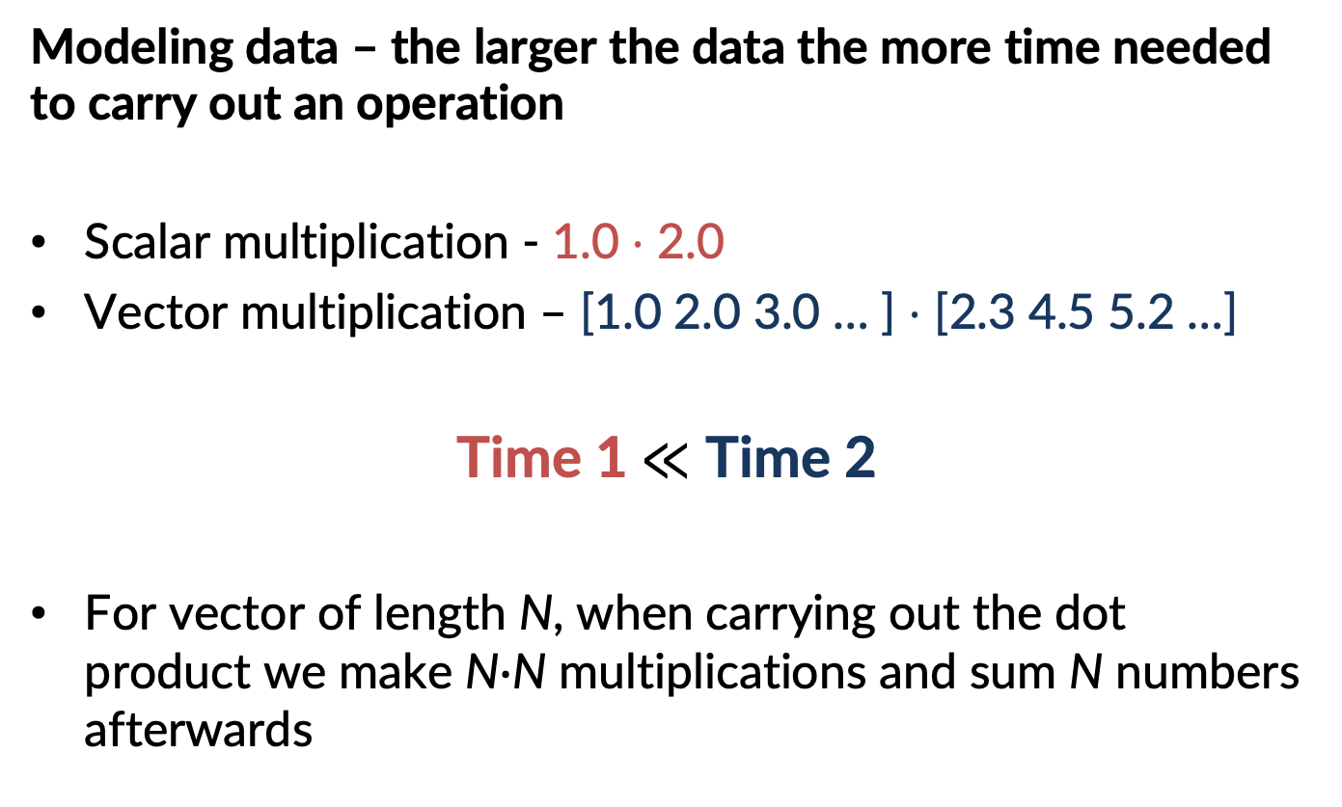
Memory & time to compute
Modeling data – the larger the data the more time needed to carry out an operation
Scalar multiplication - 1.0 $⋅$ 2.0
Vector multiplication – [1.0 2.0 3.0 … ] $⋅$ [2.3 4.5 5.2 …]
Time 1$≪$ Time 2
For vector of length N, when carrying out the dot product we make N$∙$N multiplications and sum N numbers afterwards

Slide 23


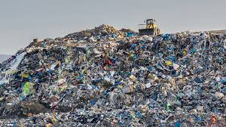
Challenges
Evaluating models, extracting properties from/using large dataset is computationally demanding: high memory cost & time demand
We need answers now for important problems
Cure to COVID 19 / drug design
Global warming - ecological forecasting
Real-time sensing, learning, decision-making
Detecting hazardous weather
Ref: The National Science Foundation's (NSF) Harnessing the Data Revolution (HDR) Big Idea

Slide 24
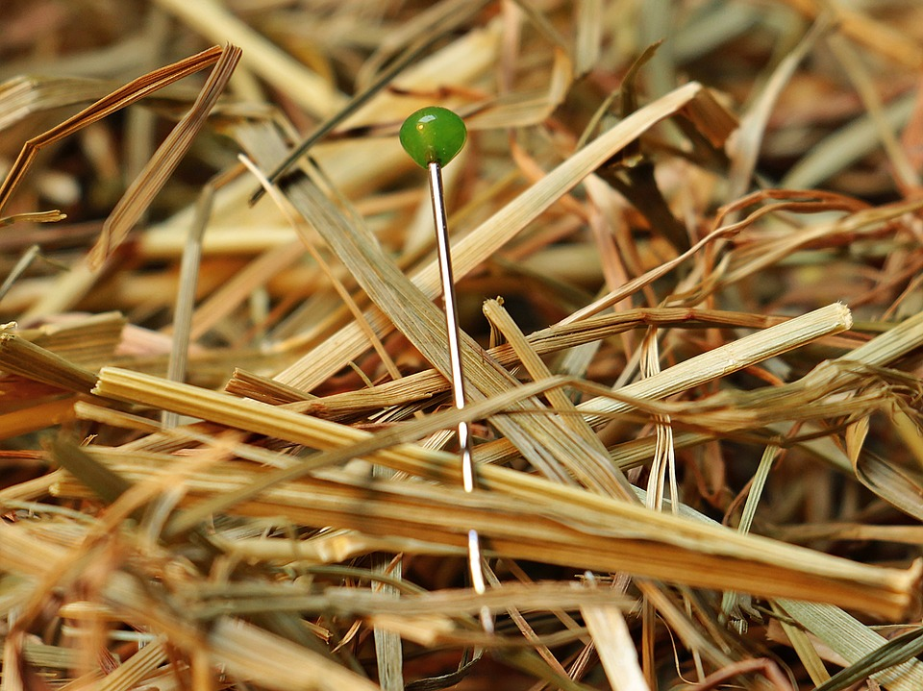
Accelerating search & modeling?
How can we rapidly and accurately analyze large sets to extract / model what is of interest?
Data Science
&
Software Engineering

Slide 25

New paradigm of data-intensive discovery and innovation
Deep domain knowledge
Data Science
Data management
Databases, scalable data handling, data curation
Machine learning
Regression & classification
Supervised & unsupervised
Statistics
Visualization
Software engineering
Molecular Data Scientist
Knows thermodynamics and machine learning

Slide 26
Data management
You’ve got lots of data, how do you manage it?
Not about lab notebooks anymore!
Databases
Structure and store large, heterogeneous data
Slice, subset, and retrieve it efficiently
Track provenance and metadata of your data
Relational databases
Structured Query Language (SQL)
Scalable data processing systems

Slide 27
New paradigm of data-intensive discovery and innovation
Deep domain knowledge
Data Science
Data management
Databases, scalable data handling, data curation
Machine learning
Regression & classification
Supervised & unsupervised
Statistics
Visualization
Software engineering
Molecular Data Scientist
Knows thermodynamics and machine learning

Slide 28

Machine learning
www.slideshare.net/awahid

Slide 29
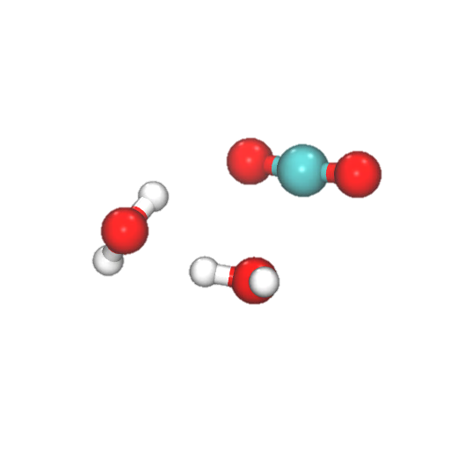
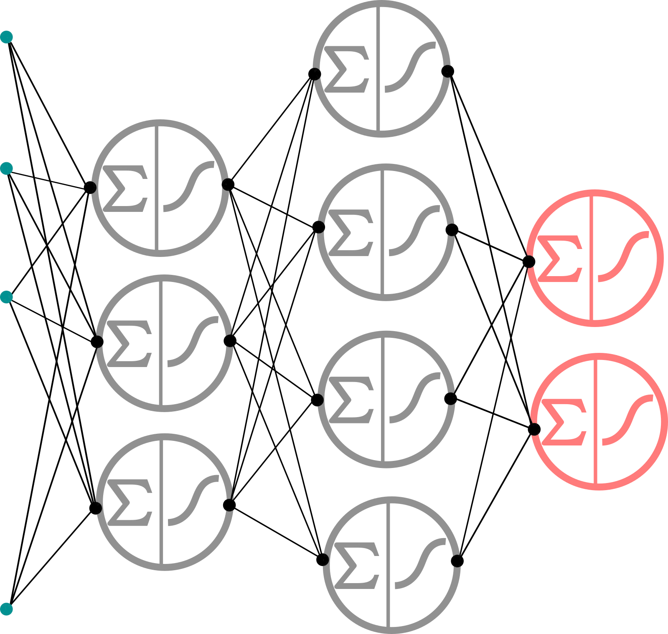

Machine learning
Regression: Predict a numerical response from input features
Example: predict reaction rate constant products k(T)Q(T) from a data set of 6.9 million data points
+
k(T)Q(T)
[1] Komp, E.; Valleau, S. J. Phys. Chem. A., 124, 41, 8607–8613, 2020

Slide 30
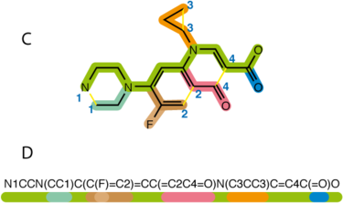
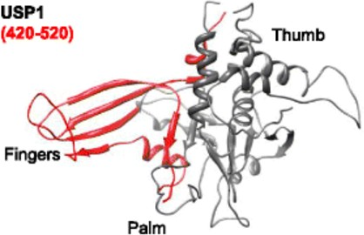


Machine learning
Example: predict binding affinity of small molecules to cancer drug target
+
=?
Database of 400,000 drug like molecules
Experimental inhibition activities against cancer drug target
Build a regression model that relates molecular features to a numerical measure of inhibition, dissociation constant (Kd)
For a new small molecule, predict the Kd?^{1,2}
https://github.com/BeckResearchLab/USP-inhibition
https://github.com/BeckResearchLab/small-molecule-design-toolkit
Pearl Philip & Rahul Avadhoot

Slide 31
Machine learning
Example: Predict molecular property or activity from molecular structure
Quantitative Structure Property Relationship (QSPR)
Quantitative Structure Activity Relationship (QSAR)
https://github.com/BeckResearchLab/small-molecule-design-toolkit

Slide 32
Machine learning
Regression
Features or predictors
Outcome
Molecule | Diffusion (nm/s) | Molecular Weight | C=C bonds | H-bond donors | H-bond acceptors | Kd (fM)
1 | 8 | 66 | 1 | 0 | 0 | 1
2 | 5 | 44 | 2 | 1 | 0 | 12
3 | 6 | 95 | 0 | 2 | 0 | 14
4 | 7 | 63 | 4 | 0 | 0 | 1
5 | 8 | 65 | 1 | 0 | 1 | 4
6 | 3 | 91 | 1 | 1 | 1 | 3
7 | 6 | 94 | 2 | 0 | 1 | 2
8 | 3 | 96 | 1 | 2 | 1 | 2
9 | 7 | 57 | 3 | 1 | 1 | 6
10 | 6 | 121 | 1 | 0 | 0 | 8

Slide 33

Machine learning
Regression
Features or predictors
Outcome
Molecule | Diffusion (nm/s) | Molecular Weight | C=C bonds | H-bond donors | H-bond acceptors | Kd (fM)
1 | 8 | 66 | 1 | 0 | 0 | 1
2 | 5 | 44 | 2 | 1 | 0 | 12
3 | 6 | 95 | 0 | 2 | 0 | 14
4 | 7 | 63 | 4 | 0 | 0 | 1
5 | 8 | 65 | 1 | 0 | 1 | 4
6 | 3 | 91 | 1 | 1 | 1 | 3
7 | 6 | 94 | 2 | 0 | 1 | 2
8 | 3 | 96 | 1 | 2 | 1 | 2
9 | 7 | 57 | 3 | 1 | 1 | 6
10 | 6 | 121 | 1 | 0 | 0 | ???????

Slide 34
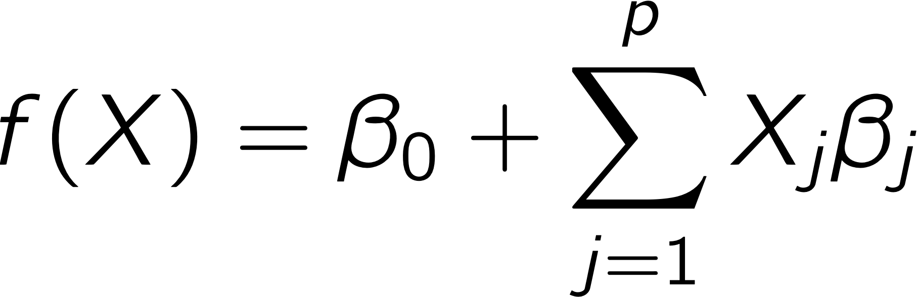
Machine learning
Regression
Linear regression
LASSO regression (least absolute shrinkage and selection operator)
Variable selection (which features are actually useful)
Regularization (avoid overfitting to your training data)
Molecule | Diffusion (nm/s) | Molecular Weight | C=C bonds | H-bond donors | H-bond acceptors | Kd (fM)
1 | 8 | 66 | 1 | 0 | 0 | 1
2 | 5 | 44 | 2 | 1 | 0 | 12
3 | 6 | 95 | 0 | 2 | 0 | 14
4 | 7 | 63 | 4 | 0 | 0 | 1
5 | 8 | 65 | 1 | 0 | 1 | 4
6 | 3 | 91 | 1 | 1 | 1 | 3
7 | 6 | 94 | 2 | 0 | 1 | 2
8 | 3 | 96 | 1 | 2 | 1 | 2
9 | 7 | 57 | 3 | 1 | 1 | 6

Slide 35
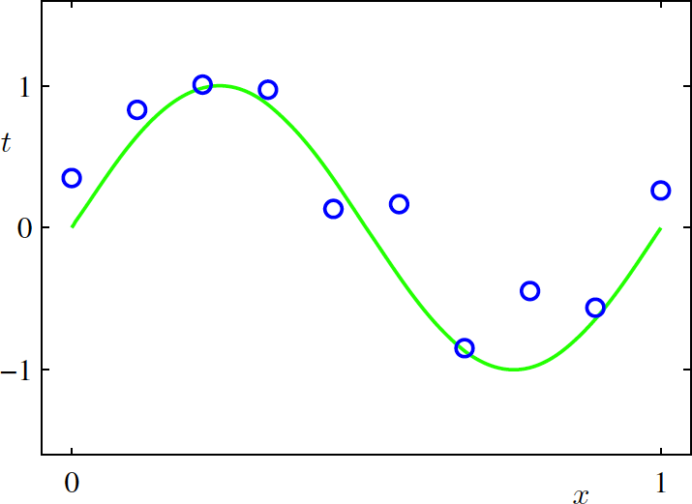
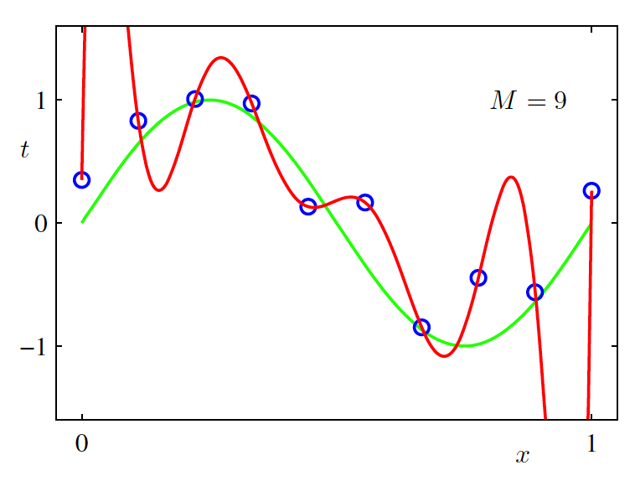
Machine learning
Overfitting
“With four parameters I can fit an elephant, and with five I can make him wiggle his trunk.”
- John von Neumann
Points generated from green
function f(x) = sin(2𝛑x) + noise
Pattern Recognition and Machine Learning. Bishop, 2006.
Fitting to points with a polynomial with order M = 9

Slide 36
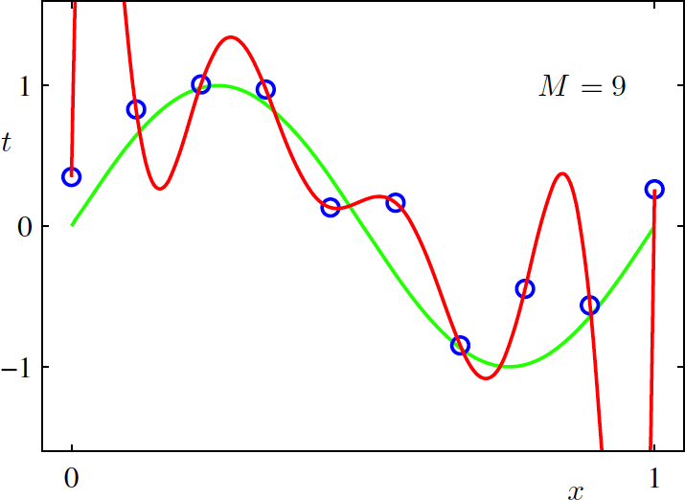
Machine learning
Overfitting
Making your model too specific to training data
Performs poorly on new data relative to ”truth”
Points generated from green
function f(x) = sin(2𝛑x) + noise
Pattern Recognition and Machine Learning. Bishop, 2006.
Fitting to points with a polynomial with order M = 9

Slide 37
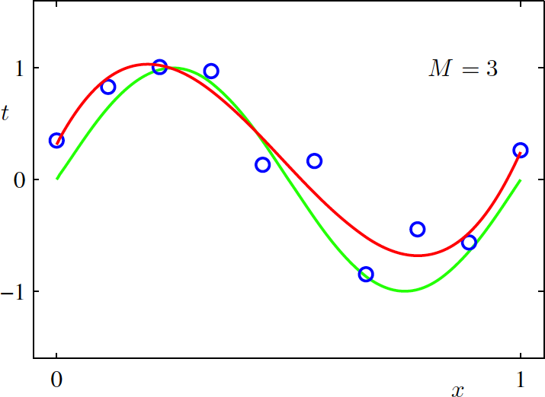
Machine learning
Proper fitting
Still fits the training data
Performs better on new data
Points generated from green
function f(x) = sin(2𝛑x) + noise
Pattern Recognition and Machine Learning. Bishop, 2006.
Fitting to points with a polynomial with order M = 3

Slide 38

Machine learning
Train / test split
How can you identify overfitting?
Partition your input data into
Training set (e.g. 80%) used to build the ML model
Test set (e.g. 20%) used to validate and characterize the error in the model
Data set
Training data
Testing data
Never ever ever ever ever contaminate your model training with data from the test set!!!

Slide 39
Machine learning
Regression
– Decision trees
Molecular weight > 65
No Yes
H-bond donors > 1
Diffusion > 6
No
Yes
No
Yes
H-bond acceptors < 1
C=C bonds > 0
Kd = 3
Diffusion > 3
No
Yes
No
Yes
No
Yes
Kd = 2
Kd = 4
Kd = 8
Kd = 12
Kd = 4
Kd = 14
Notes:
A decision tree is a decision support tool that uses a tree-like model of decisions and their possible consequences, including chance event outcomes, resource costs, and utility. It is one way to display an algorithm that only contains conditional control statements. A decision tree is a flowchart-like structure in which each internal node represents a "test" on an attribute (e.g. whether a coin flip comes up heads or tails), each branch represents the outcome of the test, and each leaf node represents a class label (decision taken after computing all attributes). The paths from root to leaf represent classification rules.

Slide 40
New paradigm of data-intensive discovery and innovation
Deep domain knowledge
Data Science
Data management
Databases, scalable data handling, data curation
Machine learning
Regression & classification
Supervised & unsupervised
Statistics
Visualization
Software engineering
Molecular Data Scientist
Knows thermodynamics and machine learning

Slide 41
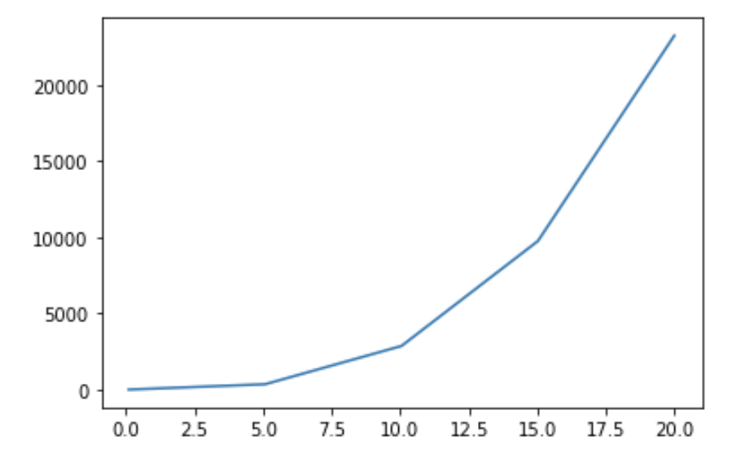
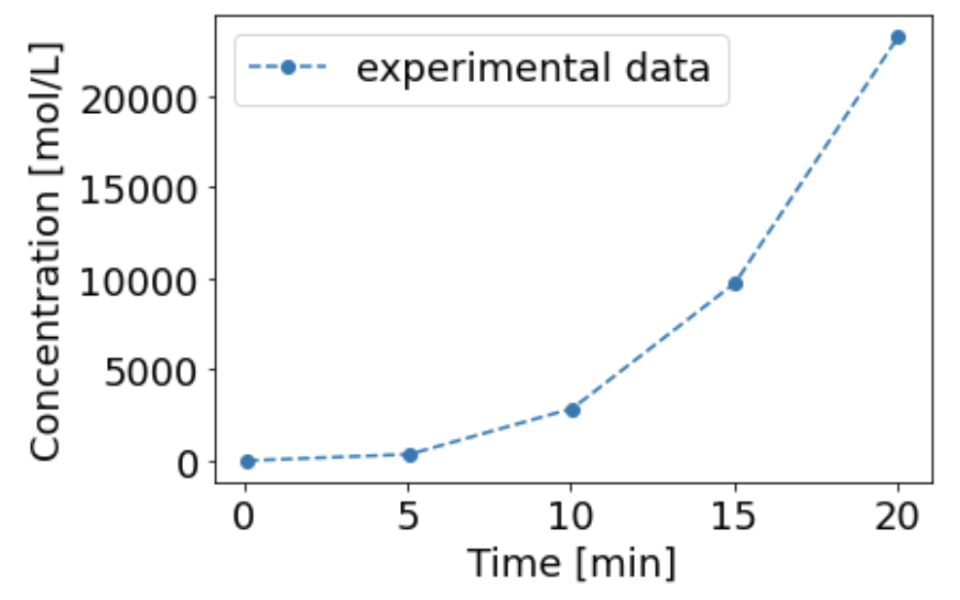
Visualization
How can we clearly and accurately represent data?

Slide 42
New paradigm of data-intensive discovery and innovation
Deep domain knowledge
Data Science
Data management
Databases, scalable data handling, data curation
Machine learning
Regression & classification
Supervised & unsupervised
Statistics
Visualization
Software engineering
Molecular Data Scientist
Knows thermodynamics and machine learning

Slide 43
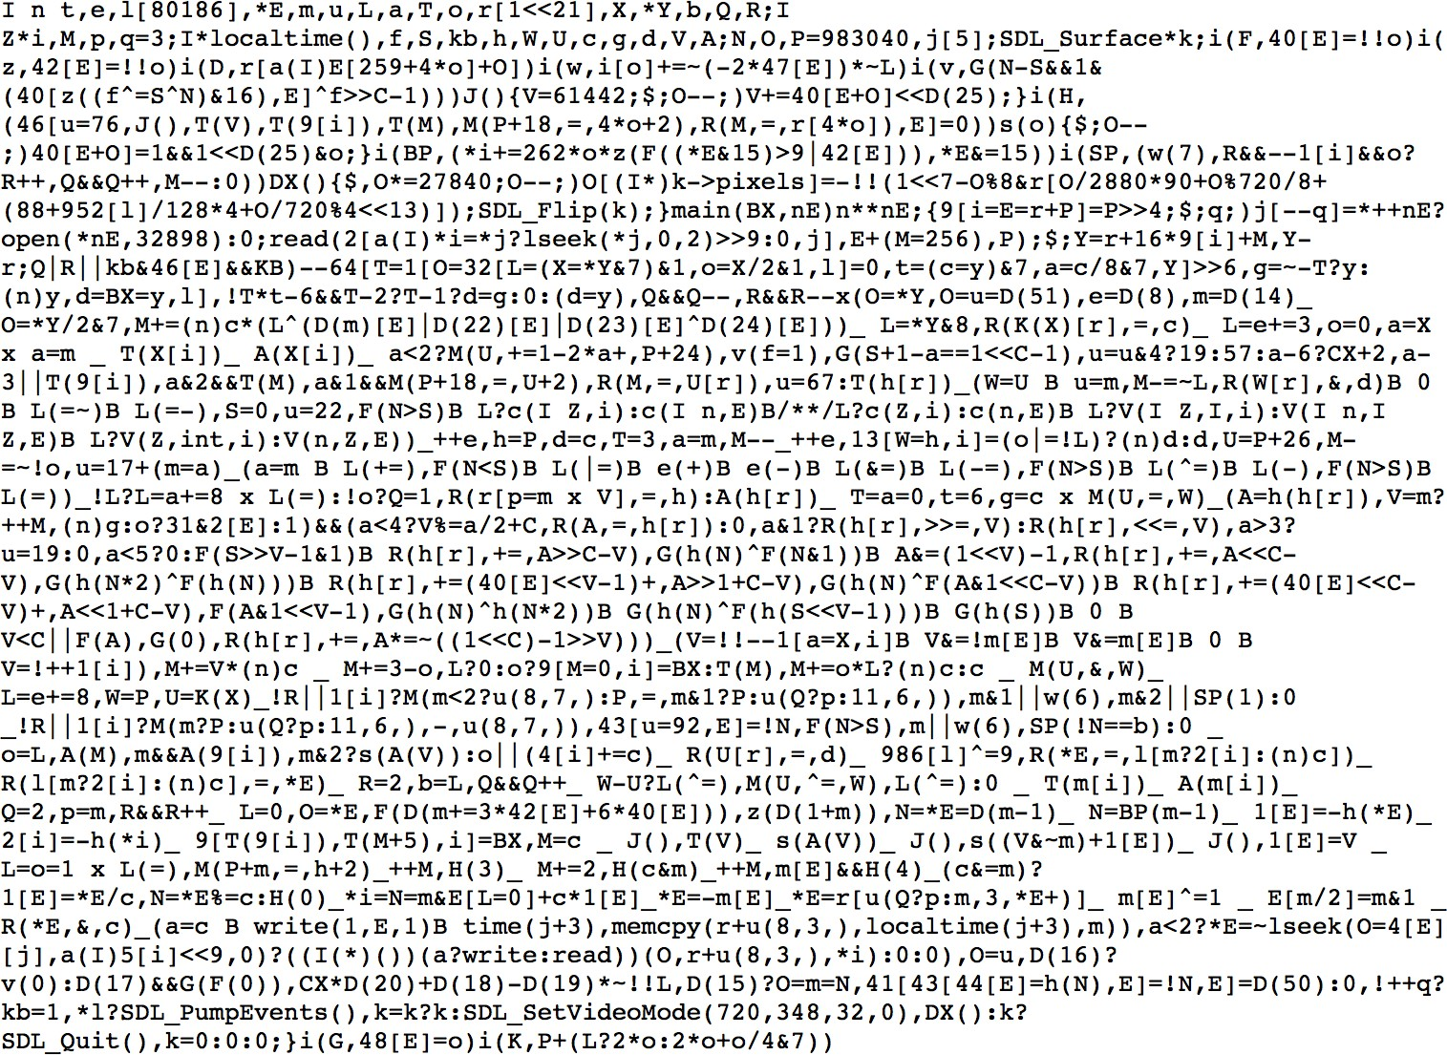
Software engineering
Your code should not look like this:

Slide 44
Software engineering
Scientific and engineering software tools are first class research products!
Programming is not software engineering
This is what CHEME/CHEM/MSE 546 is about!

Slide 45
Meet each other!
The best way to learn is from each other!
We will now move you to a breakout room ☺
Introduce yourselves (1st names and departments)
Appoint 1 facilitator (soonest birthday, e.g. today) and 1 scribe (farthest birthday, e.g., yesterday)
Go around the table, each person answers each of the following questions, then move onto next question.
What is Data Science?
What/who is a data scientist?
Why is Data Science a thing all of a sudden?
Why does Data Science matter, broadly, in my field of [insert]?
Why does Data Science matter, specifically, in my sub-discipline of [insert]?

Slide 46
What did you think?
Facilitator & scribe give us your update!

Slide 47

Data: Don’t be afraid of it!

Slide 48
DIRECT to the rescue!
Data Science Option
Data Intensive Research Enabling Clean Tech (DIRECT)
ChemE 545: Data Science Methods for Clean Energy Research
ChemE 546: Software Engineering for Molecular Data Scientists
ChemE 547: Capstone Project in Molecular Data Science

Slide 49
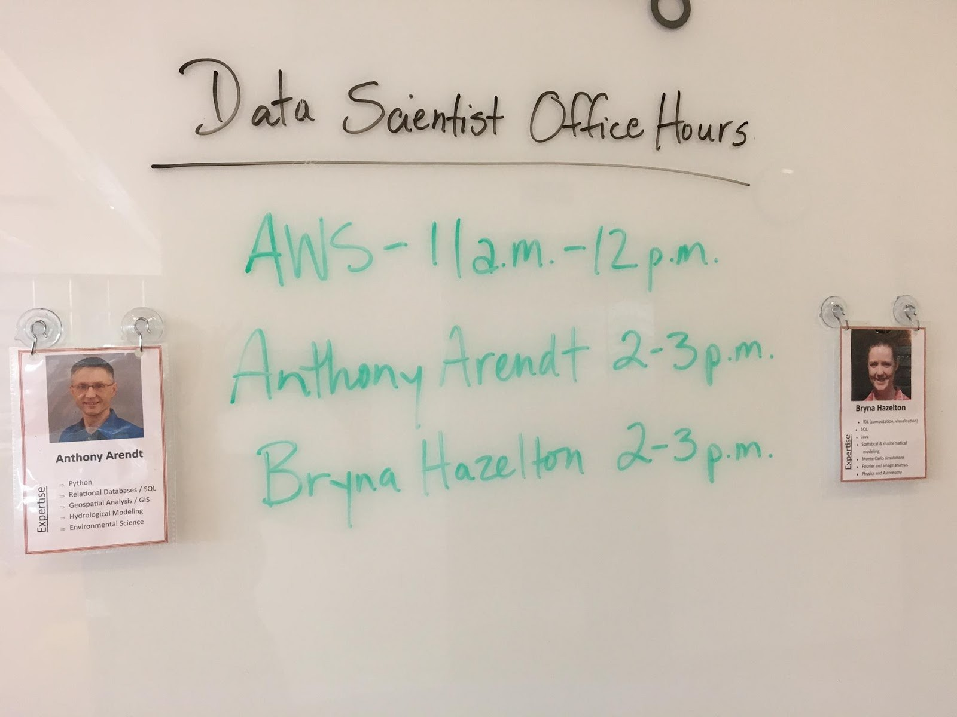

eScience to the rescue!
Data Scientist Office Hours
Get help with your data science questions
Data management
Machine learning
Statistics
Visualization
Software engineering

Slide 50
What is data science?
Quick in class exercise
Alone: Define Data Science by answering as many of the following questions as you can (write or type your answer)
What is Data Science?
What/who is a data scientist?
Why is Data Science a thing all of a sudden?
Why does Data Science matter, broadly, in my field of [insert]?
Why does Data Science matter, specifically, in my sub-discipline of [insert]?
~5 min working alone – take some notes!

Slide 51
Zoom chat your responses
After 5min we will ask you to write some responses to each question and share them with others

Slide 52
Questions?

Slide 53
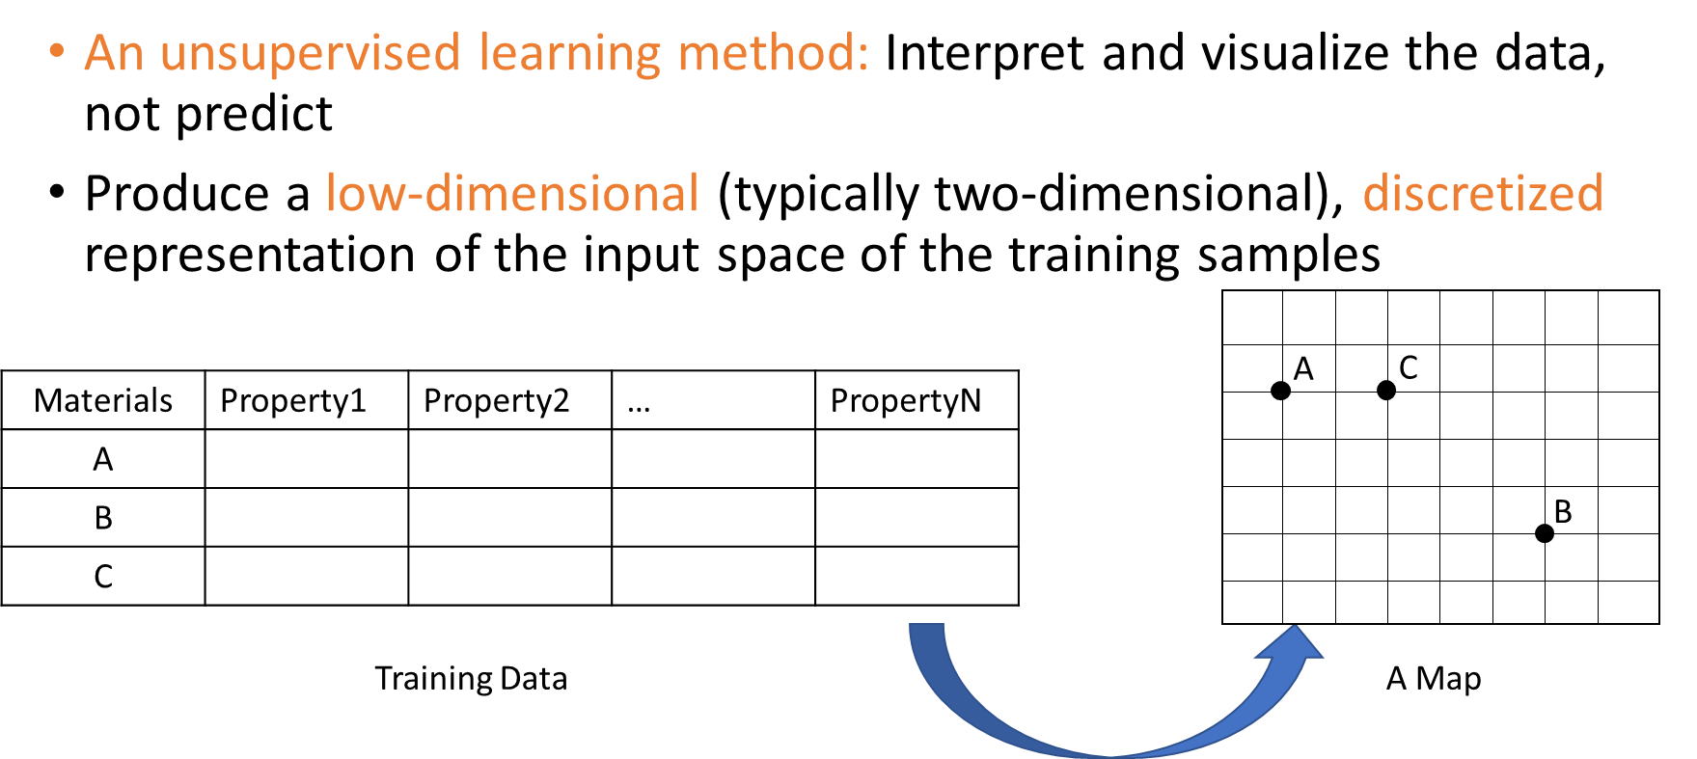


Machine learning
Clustering: Classification of materials based on self-organizing maps (SOM)
Results in Materials 4, 100020 (2019)
Jimin Qian (MSE)
Fumio Ohuchi (MSE)

Slide 54
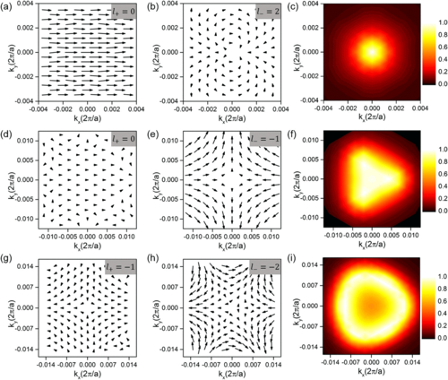
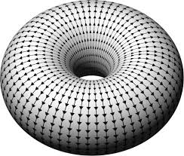
Visualization
How can you convey a complex multivariate data set to stakeholders & peers?
Mapping 4-component array defined on the surface of 2 torus to 2D vector plot
Ref: Phys. Rev. Lett. 120, 087402

Slide 55
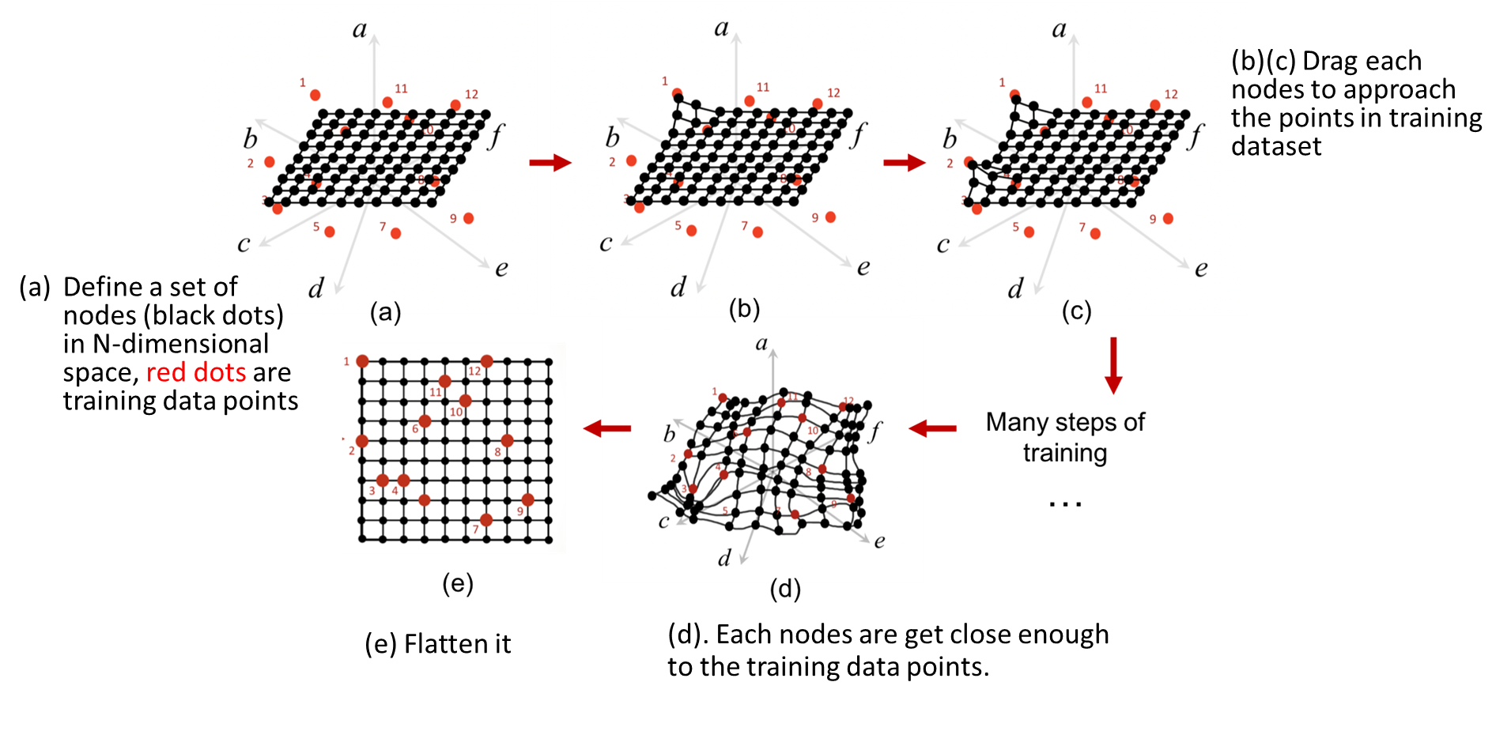
Machine learning
Clustering: Classification of materials based on self-organizing maps (SOM)

Slide 56
Machine learning
Clustering: Classification of materials based on self-organizing maps (SOM)
Properties:
'Density (lb/in^3)',"Young's modulus (10^6 psi)", "Poisson's ratio",'Hardness - Vickers (HV)', 'Bulk modulus (10^6 psi)', 'Yield strength (elastic limit) (ksi)','Shear modulus (10^6 psi)','Tensile strength (ksi)', 'Flexural modulus (10^6 psi)', 'Flexural strength (modulus of rupture) (ksi)', 'Fatigue strength at 10^7 cycles (ksi)', 'Compressive strength (ksi)', 'Fracture toughness (ksi.in^0.5)', 'Melting point (°F)', 'Thermal conductivity (BTU/hr.ft.°F)', 'Specific heat capacity (BTU/lb.°F)', 'Thermal expansion coefficient (μstrain/°F)', 'Latent heat of fusion (BTU/lb)', 'Electrical conductivity (%IACS)', 'Mechanical loss coefficient (tan delta)','Acoustic velocity (in/s)'
398 materials
Each material has 21 properties

Slide 57
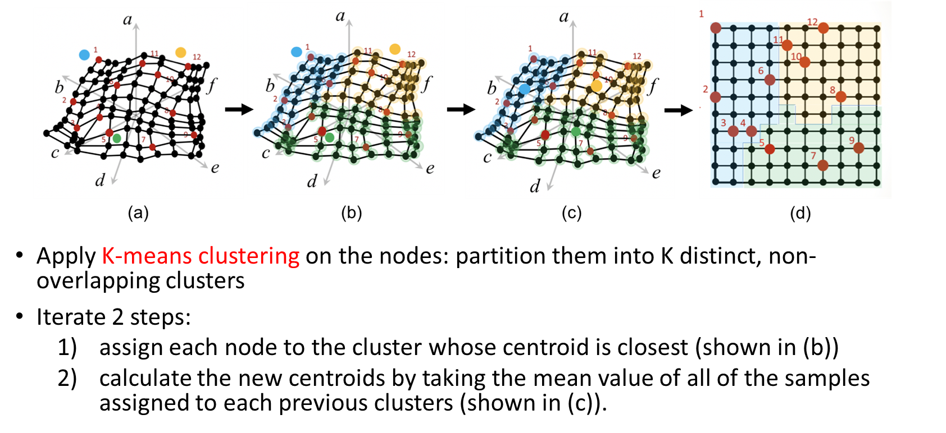
Machine learning
Visualizing the self-organizing maps by using clustering map

Slide 58
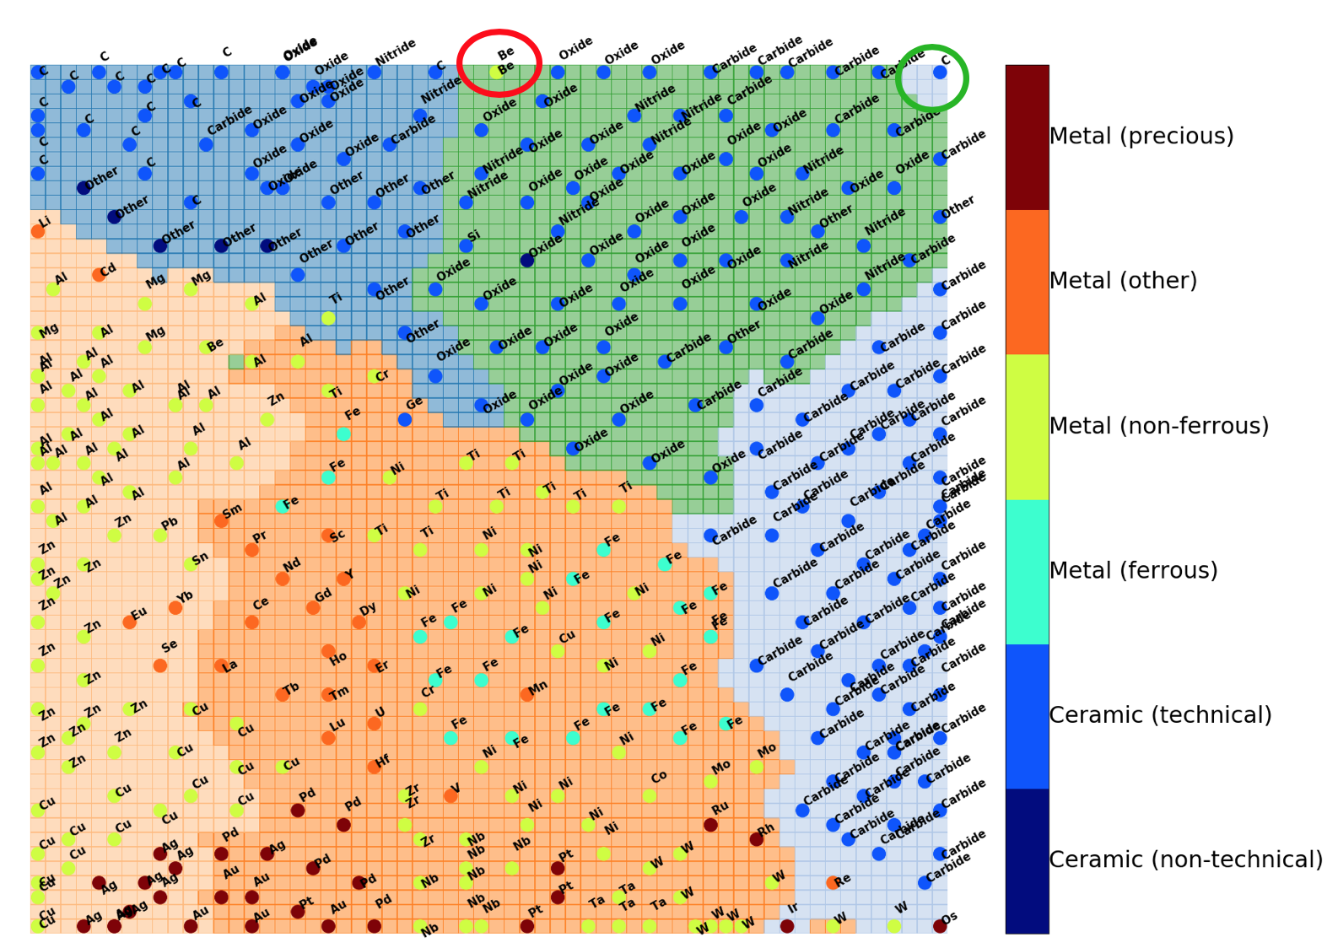
Machine learning
Visualizing the self-organizing maps by using clustering map
Colored each point by it’s category
The label/color of each points can indicate qualitative/categorical property of material
Jimin Qian (MSE)
Fumio Ohuchi (MSE)

Slide 59






Acknowledgements
Beck Research Lab
Pearl Philip (ChemE, GSK)
Rahul Avadhoot (ChemE)
Jiayuan Guo (ChemE)
Alexey Gilman (ChemE, PhD)
Gut microbiome & health
Jisun Paik (Comparative Medicine)
Showcase examples
Elizabeth Nance (ChemE)
Chad Curtis (ChemE)
Mike McKenna (ChemE)
Wes Tatum (MSE)
Luscombe (MSE)
Jimin Qian (MSE)
Fumio & Huang (MSE)
Jay Rutherford (ChemE)
Posner (ChemE + MechE)
Blake Hough (ChemE, PhD)
Pfaendtner & Schwartz

